Slide 1
Coding-Foundation

Slide 2

Coding-foundation
Discussion
What goes into making a great developer?

Slide 3

Table of content
We will learn via a Case study
Understand and fix some code
Coding Guidelines
Code Organization
Gdb, valgrind
Learn about
Optimal Abstract Data Types
Wrapper Functions
Finite State Machines
Fix some more code
Understand about Cyclomatic Complexity
Create some code
Make some code better

Slide 4
Coding-foundation
Objectives
To be a better developer by being able to:
Write code as per Coding Guidelines
Use Abstract Data Types and Wrapper Functions
Demonstrate critical programming skills including
Organizing code sensibly
Using debuggers, editors and memory leak tools expertly

Slide 5

Coding-foundation
Static Code Analysis
Here we go!

Slide 6
Coding-foundation
Case study – Switch & Subscribers
Two Components
Switch
Subscribers
Flow of exchange of data between the switch and the subscribers
Switch is waiting for a subscriber to connect
A subscriber connects to the switch
The switch creates a call object for this subscriber connection
The subscriber and the switch exchange data
The call object on the switch goes through various states during this phase
Subscriber disconnects
Call object is removed on the switch
The switch goes through this process for various subscribers again and again

Slide 7
Coding-foundation
Case study - Switch & Subscribers - Call Flow
Subscriber
Switch
Socket Connect
Call object
Created
Digits Dialed
Answer
Data sent to switch
Data sent to subscriber
Release connection
Release confirmed
Call object
Deleted

Slide 8
Coding-foundation
Code Walk-through
Let us look at the “switch”
vim and ctags
Code Organization
Coding Guidelines
Notes:
Objective is to understand effective use of vim/ctags, code organization and coding guidelines.
Let us not get into code details here! Focus on traversing the code efficiently.

Slide 9
Coding-foundation
Abstract Data Types
Bad programmers worry about the code. Good programmers worry about data structures and their relationships. - Linus Torvalds
Get your data structures correct first, and the rest of the program will write itself. - Davids Johnson
A list is only as strong as its weakest link.
- Donald Knuth

Slide 10
Coding-foundation
Abstract Data Types
An abstract data type is a data type packaged with the operations that are meaningful for the data type.
We then encapsulate the data and the operations on the data and hide them from the user.
Abstract data type requires:
Definition of data.
Definition of operations.
Encapsulation of data and operation.

Slide 11
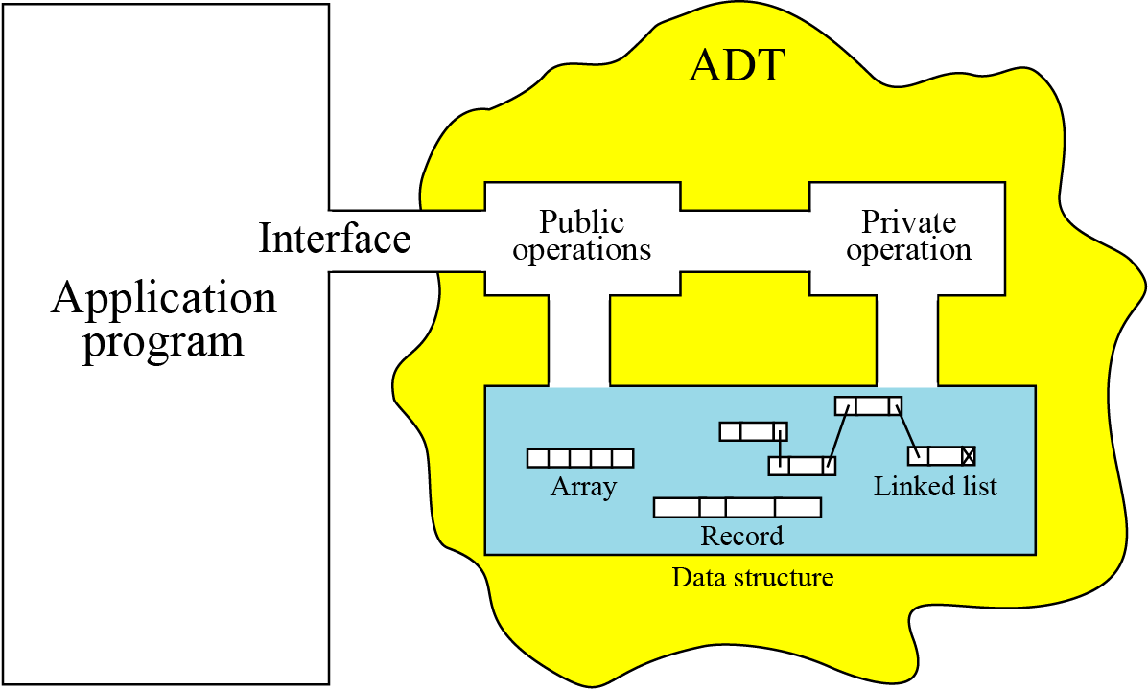
Coding-foundation
Abstract Data Types
Notes:
Explain the importance of creating/isolating data and related operations seperately, perhaps into a library. It can be tested in isolation and can be used by application programs.

Slide 12
Coding-foundation
Abstract Data Types
C constructs to implement an ADT.
Typedefs
Pointer to Void
Pointer to Function

Slide 13

Coding-foundation
Case Study
Let us look at the code for “switch” and analyze it from the perspectives of
Abstract Data Types and Wrapper Functions
Notes:
Use the header files

Slide 14
Coding-foundation
Case study- Switch & Subscribers
Function return types
typedef enum
{
FAILURE = 0,
SUCCESS
}ReturnType;
Array for sending / receiving data
#define MAX 64
typedef struct TrsfrPacket
{
unsigned char buffer[MAX];
}TrsfrPacket;
Notes:
Always encourage discussion- bring in your personal insight . What are problem areas, how can we make this ADT better etc.

Slide 15
Coding-foundation
Case study- Switch & Subscribers
States of a call object on the Switch
SWITCH_CALL_STATES
{
OCALL_IDLE_STATE=0,
OCALL_SETUP_INITIATED,
OCALL_INPROGRESS,
OCALL_CONNECTED,
OCALL_TERM_INITIATED,
OCALL_TERMINATED
}
Notes:
Importance of thinking through and identifying the states

Slide 16
Coding-foundation
Case study- Switch & Subscribers
Events sent by a Subscriber to the Switch
SUBSCRIBER_CALL_EVENTS
{
SUBS_EVT_OFF_HOOK=0,
SUBS_EVT_DIGITS_DIALLED,
SUBS_EVT_RELEASE,
SUBS_EVT_INVALID,
SUBS_EVT_DATA
}
Switch changes state based upon subscriber events

Slide 17
Coding-foundation
Case study- Switch & Subscribers
Subscriber call states
SUBSCRIBER_CALL_STATES
{
SUB_OFF_HOOK=0,
SUB_SETUP_INITIATED,
SUB_NPROGRESS,
SUB_CONNECTED,
SUB_TERM_INITIATED,
SUB_TERMINATED
}

Slide 18
Coding-foundation
Case study- Switch & Subscribers
Switch Events
SWITCH_CALL_EVENTS
{
EVT_IN_PROGRESS=0,
EVT_ANSWER,
EVT_RELEASE_CNF,
EVT_INVALID,
EVT_DATA,
EVT_NO_RESPONSE,
}
Subscriber changes state based upon switch events

Slide 19
Coding-foundation
Case study- Switch & Subscribers
Message Structures
#define MAX 64
typedef struct ControlMsg
{
unsigned int oSubscriber;
unsigned int tSubscriber;
}ControlMsg;
typedef struct TrsfrPacket
{
unsigned char buffer[MAX];
}TrsfrPacket;
Notes:
ControlMsg: Specifying the which subscriber it is – originating or terminal
TrsfrPacket – To send data through tcp read/write

Slide 20
Coding-foundation
Case study- Switch & Subscribers
Message Structures
#define SIZE 60
typedef struct Message
{
union{
Switch_Call_Events switchEvent;
Subscriber_Call_Events subscriberEvent;
}mtype;
union
{
unsigned char anyData[SIZE];
ControlMsg ctrlData;
}data;
}Message;
Notes:
Discuss variations if possible.
Discuss the role of a flag to handle unions while passing them around.

Slide 21
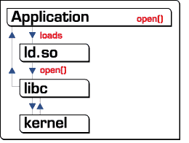
Coding-foundation
Wrapper Functions
A wrapper function is a function in a computer program whose main purpose is to call a second function with little or no additional computation.
Good uses for wrapper functions:
Hiding the complexity of a horribly complex or unsafe, low-level API,
Your wrapper must actually reduce complexity and/or increase safety for the common cases.
Making something cross-platform when you are writing a generic library or have a good reason to believe it needs to be cross-platform.

Slide 22
Coding-foundation
Wrapper Functions - Example
Function to read data over tcp
ReturnType tcpreceivedata(CommPoint channelid, unsigned char *precvbuffer, unsigned int datalength)
{
int bytesrecved = 0;
int retread = 0;
iwhile(bytesrecved < datalength)
{
retread = read(channelid,precvbuffer+bytesrecved,datalength-bytesrecved);
if(0 > retread)
{
SYS_LOG_ERROR_MESSAGE("Unable to Read data");
return FAILURE;
}
bytesrecved += retread;
}
return SUCCESS;
}
Notes:
Discuss about what “read” system call
- read(int sd, void * buf, int n) – an attempt to read “n” bytes.
- How do we make sure that the entire data is read? – here the infinite while loop

Slide 23
Coding-foundation
Wrapper Functions - Example
Function to copy “TrsfrPacket” to “Message”
ReturnType createmessagefrompacket(TrsfrPacket *precvbuffer, Message *pmsg)
{
if((NULL == precvbuffer) || (NULL == pmsg))
{
SYS_LOG_ERROR_MESSAGE("packet/msg references invalid");
return FAILURE;
}
memcpy(pmsg, precvbuffer->buffer, sizeof(Message));
return SUCCESS;
}

Slide 24
Coding-foundation
Wrapper Functions - Example
Function to copy “Message” to “TrsfrPacket”
ReturnType createpacketfrommessage(Message *pmsg, TrsfrPacket *precvbuffer)
{
if((NULL == precvbuffer) || (NULL == pmsg))
{
SYS_LOG_ERROR_MESSAGE("packet/msg references invalid");
return FAILURE;
}
memcpy(precvbuffer->buffer, pmsg, sizeof(Message));
return SUCCESS;
}

Slide 25
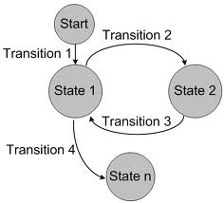
Coding-foundation
Finite State Machine (FSM)
In FSM
Events result in action defined by the protocol/system behavior or specification
Event are processed one at a time
Asynchronous in nature and are generated by messages from other nodes or Timer expiry
FSM implementation in `C`
switch/case construct
Array of function pointers

Slide 26
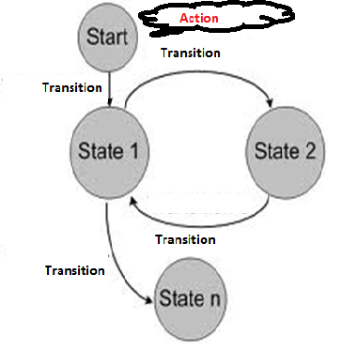
Coding-foundation
Finite State Machine (FSM)
#define MAX_STATES 3
#define MAX_EVENTS 3
typedef enum {
STATE_A=0,
STATE_B,
STATE_C
}state;
typedef enum {
EVENT_1=0,
EVENT_2,
EVENT_3
}event;
state g_state;
event g_event;

Slide 27
Coding-foundation
Finite State Machine (FSM)
Simple FSM implementation – using switch/case
switch (g_state) {
case STATE_A:
switch (g_event) {
case EVENT_1: // Action …
g_state = STATE_B; // Transition
break;
case EVENT_2: …
g_state = STATE_C;
break;
default: …
}
case STATE_B: …
case STATE_C:
}

Slide 28
Coding-foundation
Finite State Machine (FSM)
Simple FSM implementation – Using Array of Function Pointers
typedef int (*p_funct)(char *, char *);
p_funct state_machine [MAX_STATE][MAX_EVENTS];
extern int process_EVENT_1_in_STATE_A (char *, char *);
extern int process_EVENT_2_in_STATE_A (char *, char *);
extern int process_EVENT_1_in_STATE_B (char *, char *);
extern int process_EVENT_2_in_STATE_B (char *, char *);
…
extern int process_unhandled_event (char *, char *);

Slide 29
Coding-foundation
Finite State Machine (FSM)
Simple FSM implementation – Using Array of Function Pointers
/* Initialize state_machine */
…
state_machine [STATE_A][EVENT_1] = process_EVENT_1_in_STATE_A ;
state_machine [STATE_A][EVENT_2] = process_EVENT_2_in_STATE_A ;
state_machine [STATE_A][EVENT_3] = process_unhandled_event ;
…
state_machine [STATE_B][EVENT_1] = process_EVENT_1_in_STATE_B ;
…
/* Invocation of the state_machine */
…
result = (state_machine [g_state][g_event]) ((char*)p_buffer, (char*)p_msg);
…

Slide 30
Coding-foundation
Case study - Switch & Subscribers - Call Flow
Subscriber
Event
Switch
Call State
Socket Connect
Call object
Created
OCALL_IDLE_STATE
SUBS_EVT_DIGITS_DIALLED
OCALL_SETUP_INITIATED
SWITCH_EVT_ANSWER
OCALL_CONNECTED
SUBS_EVT_DATA
SWITCH_EVT_DATA
SUBS_EVT_RELEASE
SWITCH_EVT_RELEASE_CNF
OCALL_TERMINATED
Call object
Deleted
Notes:
Briefly discuss FSM (more later)
Relate to a simple telephone call and the various states it can have.
Run the binaries and show them the behaviour

Slide 31
Coding-foundation
Finite State Machine (FSM)
Simple FSM implementation – Using Array of Function Pointers
/* Initialize state_machine */
…
state_machine [STATE_A][EVENT_1] = process_EVENT_1_in_STATE_A ;
state_machine [STATE_A][EVENT_2] = process_EVENT_2_in_STATE_A ;
state_machine [STATE_A][EVENT_3] = process_unhandled_event ;
…
state_machine [STATE_B][EVENT_1] = process_EVENT_1_in_STATE_B ;
…
/* Invocation of the state_machine */
…
result = (state_machine [g_state][g_event]) ((char*)p_buffer, (char*)p_msg);
…

Slide 32
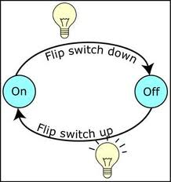
Coding-foundation
FSM - Practice
Let us convert the switch ..case based FSM into Array of Function Pointer based

Slide 33
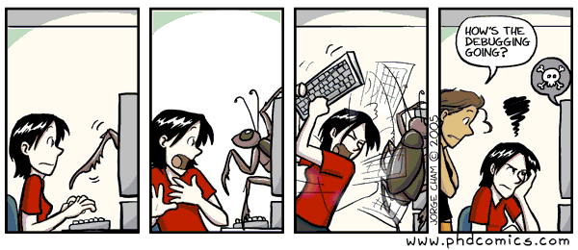
Coding-foundation
Debugging
“ It's hard enough to find an error in your code when you're looking for it; it's even harder when you've assumed your code is error-free. ”
Steve McConnell

Slide 34

Coding-foundation
Features of Debugger
Typical Features of a debugger ?
Check the order of statement execution in a program.
Evaluate a variable, parameter, or (possibly) an expression at a particular point during program execution.
Determine where execution was occurring in a program when a program misbehaves/crashes, even if the crash was in a library.
Stop a program’s execution at a particular statement and analyze

Slide 35
Coding-foundation
Debugger Operations
Operations
Setting a Breakpoint
This operation is used to cause a program that is executing in the debugger to suspend itself, permitting debugging.
Resume Execution
This operation restarts a program that is in debugging mode. The program will execute until it terminates, or encounters a breakpoint or other suspend directive.
Watching Variables, Changing their values at run time
Print value
At any time during a debugging session, you may examine the value of a variable via a watch. You can even change that!
Analyzing the core file
When your process executes an invalid instruction, the operating system produces a core dump. With the help of gdb, this core file can be analyzed to see what the problem was.
Backtrace - Analyzing the stack frames
When your program has stopped, the first thing you need to know is where it stopped and how it got there. View the stack frames of the process!

Slide 36


Coding-foundation
Debugging - Practice
Let fix our “switch” to remove the segmentation fault / logical error

Slide 37
Coding-foundation
Cyclomatic Complexity
Controlling complexity is the essence of computer programming. — Brian Kernighan
The central enemy of reliability is complexity. — Geer et al.
Complexity kills. It sucks the life out of developers, it makes products difficult to plan, build and test, it introduces security challenges and it causes end-user and administrator frustration.
— Ray Ozzie

Slide 38
Coding-foundation
Cyclomatic Complexity
Need a tool to measure the goodness of your code!
Cyclomatic complexity is a measurement developed by Thomas McCabe to determine the stability and level of confidence in a program.
It measures the number of linearly-independent paths through a program module.
Programs with lower cyclomatic complexity are easier to understand and less risky to modify.
It provides an indication of the amount of testing (including reviews) necessary to practically avoid defects.

Slide 39
Coding-foundation
Cyclomatic Complexity - cyclo
Tips to reduce cyclometic complexity
Modularity: refactor the functions to reduce cyclomatic complexity of functions
Apply cohesion principle
Modularity: refactor you code to different files to reduce overall cyclomatic complexity

Slide 40
Coding-foundation
Implementation Time - Subscriber
Lets practice !
Let us look at “subscriber”
Implement the mentioned the functions
Fix the “main” function so that cyclomatic complexity is < 10

Slide 41
Coding-foundation
Memory Analysis
What the common memory related programming bugs?
Why are they dangerous to have?
Notes:
Common memory related programming bugs
Memory leak
Double free
Array Bound Reads and Writes (ABR , ABW)
Free Memory Reads and Writes (FMR , FMW)
Beyond Stack Reads and Writes (BSR , BSW)
Null Pointer Reads and Writes (NPR , NPW)
Un initialized Memory Reads (UMR )

Slide 42

Coding-foundation
Memory Analysis - valgrind
Valgrind will tell you about tough to find memory errors early!
Valgrind is very thorough – great to find memory leaks
Downside!
Your program will run 10 to 30 times slower then normal
Notes:
Valgrind is a “program-execution monitoring framework”.
Valgrind comes with many tools, the tool you will use most often is the memcheck tool.

Slide 43
Coding-foundation
Valgrind – Types of memory errors
Memcheck will detect and report the following types of memory errors:
Use of uninitialized memory
Reading/writing memory after it has been free'd
Reading/writing off the end of malloc'd blocks
Reading/writing inappropriate areas on the stack
Memory leaks -- where pointers to malloc'd blocks are lost forever
Mismatched use of malloc/new/new [] vs free/delete/delete []
Overlapping src and dst pointers in memcpy() and related functions

Slide 44
Coding-foundation
Example
//example.c
#include <stdlib.h>
void f(void)
{
int* x = malloc(10 * sizeof(int));
x[10] = 0; // problem 1: heap block overrun
} // problem 2: memory leak -- x not freed
int main(void)
{
f();
return 0;
}

Slide 45
Coding-foundation
Valgrind output
==19182== Invalid write of size 4
==19182== at 0x804838F: f (example.c:6)
==19182== by 0x80483AB: main (example.c:11)
==19182== Address 0x1BA45050 is 0 bytes after a block of size 40 alloc'd
==19182== at 0x1B8FF5CD: malloc (vg_replace_malloc.c:130)
==19182== by 0x8048385: f (example.c:5)
==19182== by 0x80483AB: main (example.c:11)

Slide 46
Coding-foundation
References
http://www.yolinux.com/TUTORIALS/LinuxTutorialAdvanced_vi.html
http://home3.intra.aricent.com/sites/quality/QMS/QMS-Core%20Process%20Coding.aspx
http://hpux.connect.org.uk/hppd/hpux/Development/Tools/cyclo-2.0/readme.html
http://inst.eecs.berkeley.edu/~selfpace/studyguide/9C.sg/Output/ADTs.in.C.html
http://stackoverflow.com/questions/262439/create-a-wrapper-function-for-malloc-and-free-in-c
http://www.gnu.org/software/gdb/documentation/
http://valgrind.org/docs/manual/manual.html

Slide 47

Coding-foundation
Code Development Tools
Static Analysis – splint
Code Coverage – gcov
Version Control

Slide 48

Coding-foundation
Static Analysis
What is the need of static analysis?
Notes:
Static Analysis (also referred to as static testing) is the analysis of the source code to find out potential errors
Even conscientious programmers can overlook programming errors like un-initialized memory read, memory leaks, dangling pointer references etc.
A static code analyzer helps in standardizing the process of finding such common programming mistakes
Finding the mistakes in the source code help in reducing potential run-time bugs

Slide 49
Coding-foundation
Static Analysis - splint
What are the typical errors caught by splint?
Notes:
Following are few of the frequent code errors that can be caught by Splint:
De-referencing of null pointers (Null pointers read and write)‏
Using the value of a variable without initializing it (Un-initialized Memory Read)‏
Unused declarations of variables
Type inconsistencies
Unreachable code
Ignored return values
Execution paths with no return
Dangling references usage
Memory Leaks
Returning an address from a function which is the address of a variable on the stack
There may be warnings given by the static code analyzer which are not genuine problems. This should be decided by the programmer and such warnings can be suppressed.

Slide 50

Klocwork
Coding-foundation
Let us splint our “subscriber”!

Slide 51
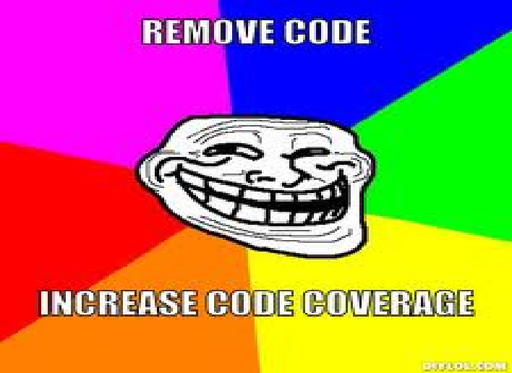
Klocwork
Coding-foundation
What is code coverage and what is its impact?
How do we increase coverage?
Notes:
Engineering projects mandate that we reach 100% code coverage
Code coverage reports must be part of Unit test results!!
Code coverage analysis is the (often iterative) process of finding and targeting “dead” or unexercised code
Create additional test cases to exercise the dead code, thereby increasing code coverage.
We will have to use gdb or create stubs to iteratively increase the coverage
The code coverage keeps getting added in the result every time you execute the executable.
Caution: as soon as you re-compile the executable, the result is re-set

Slide 52
Coding-foundation
Why Static Code Analysis is needed
Let us achieve 100% coverage on “subscriber / switch”
Notes:
Will have to discuss UT/stubs briefly

Slide 53
Klocwork
Coding-foundation
Working in isolation, you can’t “see” code changes made by team members
You can’t work in parallel on files that a co-worker is modifying
You frequently lose time and have to redo work because of lost defects or overwritten code
You have trouble determining which versions of the code you should be working on
You don’t know who on the team is working on what
You have no idea which versions of files went into a build

Slide 54
Klocwork
Coding-foundation
A successful SCM effort ensures:
Safety: Ability to recover from failure and to prevent unauthorized use
Stability: Ability to create stable, user-controlled workspaces
Control: Ability to enforce appropriate project-specific workflow controls
Auditability: Ability to know what is included in a particular build
Reproducibility: Ability to mark milestones and reconstruct configurations
Traceability: Ability to identify and reconstruct particular versions of a software product
Scalability: Ability to support small and large projects

Slide 55
Klocwork
Coding-foundation
All code changes are being tracked
Allows you to roll back changes
Allows you to track who “broke” the application
Codes changes across several developers can be synchronized
Makes it easy to backup your source code
You can work on several different copies of the same application at the same time. Example: Development and Production

Slide 56
Disclaimer
Disclaimer
Aricent Group makes no representations or warranties with respect to contents of these slides and the same are being provided “as is”. The content/materials in the slides are of a general nature and are not intended to address the specific circumstances of any particular individual or entity. The material may provide links to internet sites (for the convenience of users) over which Aricent Group has no control and for which Aricent Group assumes no responsibility for the availability or content of these external sites. While the attempt has been to acknowledge sources of materials wherever traceable to an individual or an institution; any materials not specifically acknowledged is purely unintentional

Slide 57
Revision History
Revision History
Version No | Date of Release | Author | Approved by | Changes
0.1 | 29th Oct 2013 | Shiv |  | First Draft
1.0 | 28-Dec-2013 | Shiv,Sibu |  | Updated for comments

